Slide 1
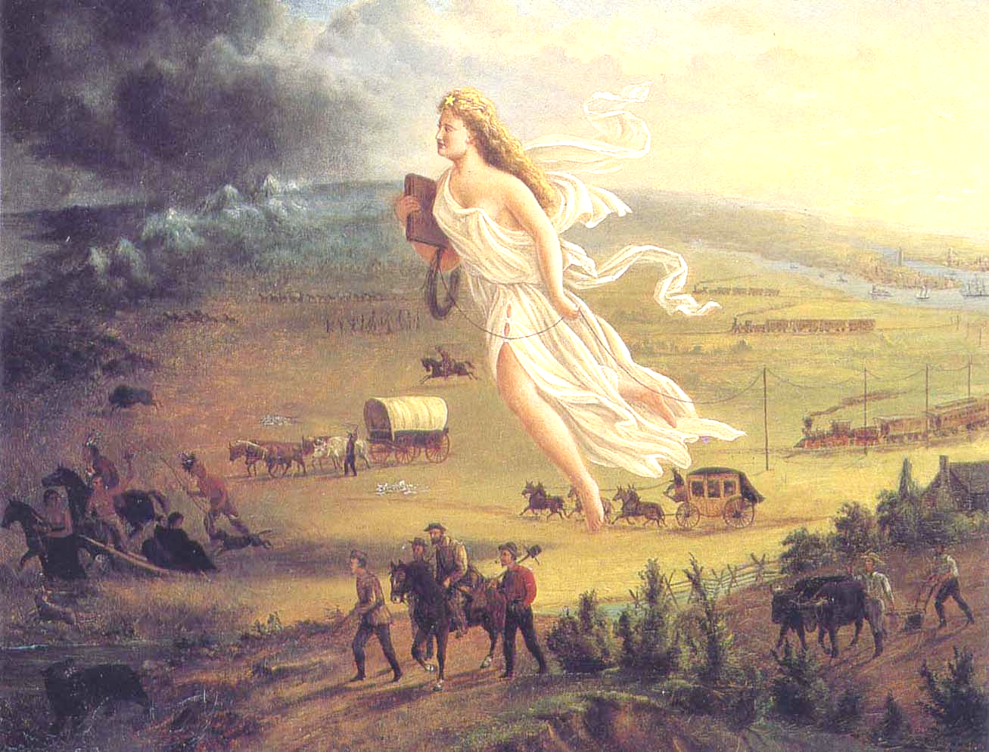
Notes:
John Gast, 1872.

Slide 2
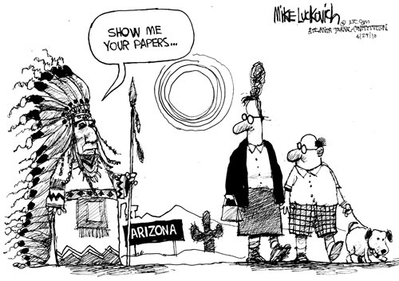
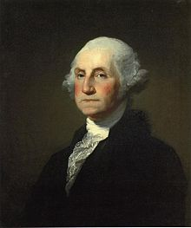
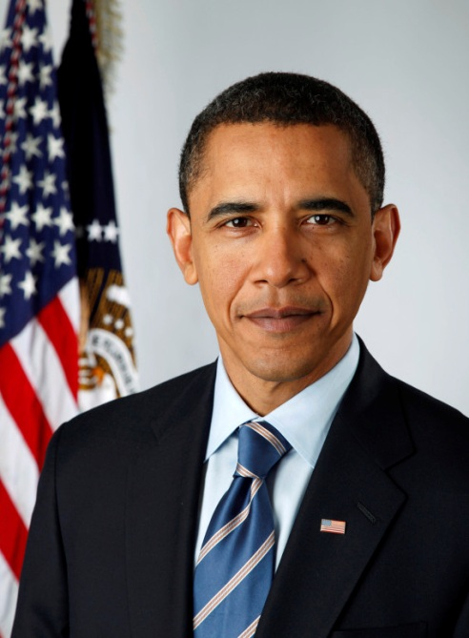
The Dark Side of American History, 1783-2014: Two Centuries of the U.S. Government’s Domestic Policies in Two Hours

Slide 3
What?

Slide 4
Why?
Who?

Slide 5
"American history is longer, larger, more various, more beautiful, and more terrible than anything anyone has ever said about it.”-James Baldwin. This class will focus on the "terrible" parts of American history. We will briefly review several controversial events and actions of the American government on US soil, from slavery to civil liberties in the age of the War on Terror, and will then discuss and debate with each other several questions relating to these topics. Some think that though our government has done wrong things in the past, we no longer engage such cruel behavior. Others think that America's past is innocent and wonderful, but that today, our policies are more cruel than they have been in the past. Can we still call ourselves the "land of the free and home of the brave?" What can we do to make up for America's past cruelties? And most importantly, how do we bring an end to those being committed right now? Warning: some disturbing photographs of war and violence will be seen.

Slide 6
Me: a disclaimer
-It’s the mileage, not the years! (same goes for older students in class)
-Bias, opinions, and facts
-I’m not God ☹
Notes:
Sources, citation. Leave at any time you want to. This is the prottype class. You guys are the pioneers.

Slide 7
When?

Slide 8
Where?

Slide 9
How?

Slide 10
-The “light side”
-Not all other countries are perfect either
-Let’s go snorkeling…
-…then scuba diving! -Change our world?

Slide 11
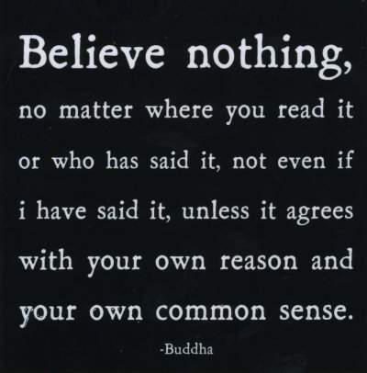
Notes:
Please, feel free to disagree with this. Feel free to disagree with everything. This course disagrees with much of what America has done. But you can also disagree with disagreement itself. Question things, and question the questioning itself afterwards. believe nothing you hear, only half of what you see. Possible that even this quotation doesn’t agree with your common sense.
Sophomore’s, juniors ,seniors?

Slide 12
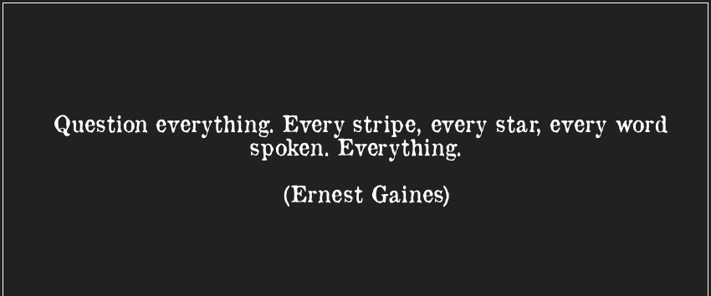
Notes:
Question questioning. Lease, speak up. This is all about disagreeing, even if you disagree with a disagreement.

Slide 13
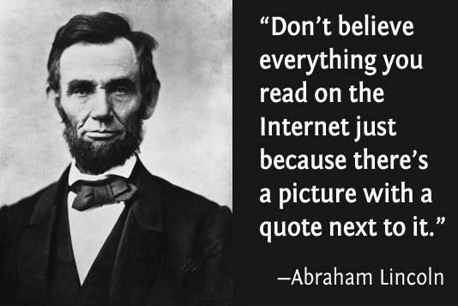

Slide 14
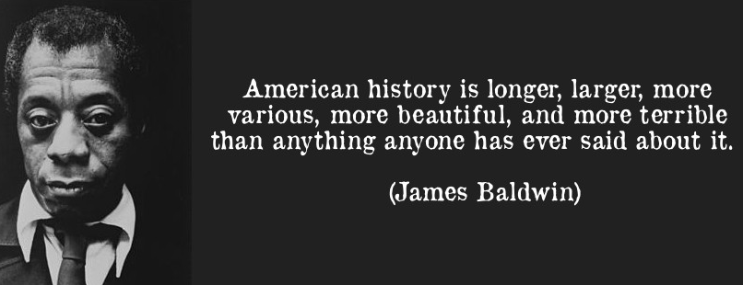
Notes:
Obviously, we’ll be focusing on the terrible. Also, does most of the beauty arise from vanquishing the terrible? Yet we will be hopeful at the end, and discuss what we can do to make up for an stop the terrible and replace it with beautiful. (writing new pledges)

Slide 15
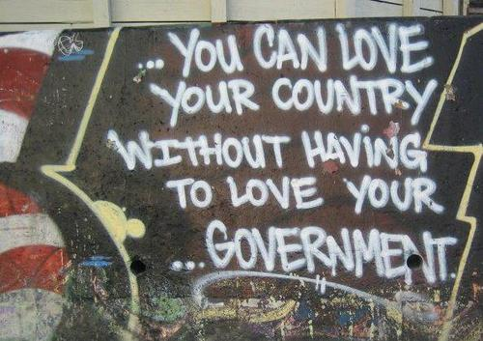

Slide 16
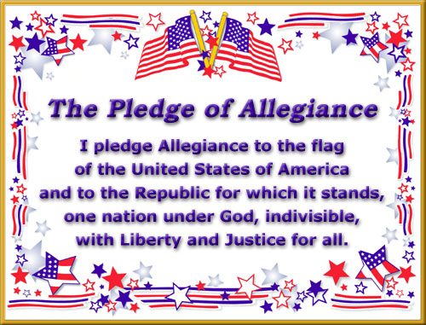

Slide 17
Notes:
John Gast, 1872.

Slide 18
Notes:
John Gast, 1872.

Slide 19
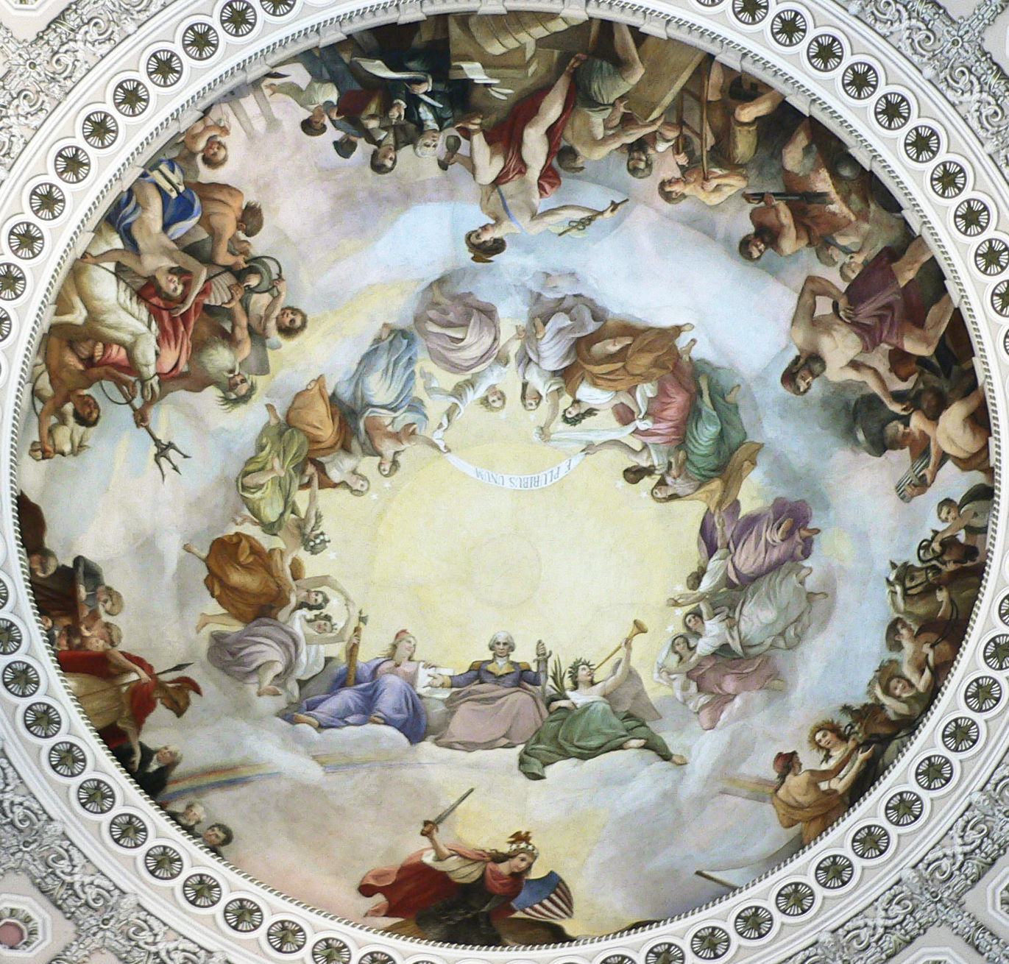

Slide 20
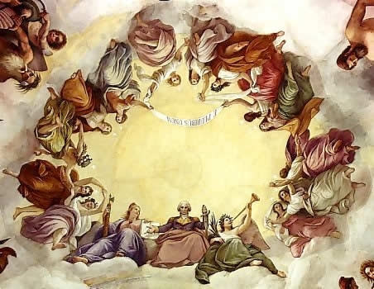

Slide 21
Slavery

Slide 22
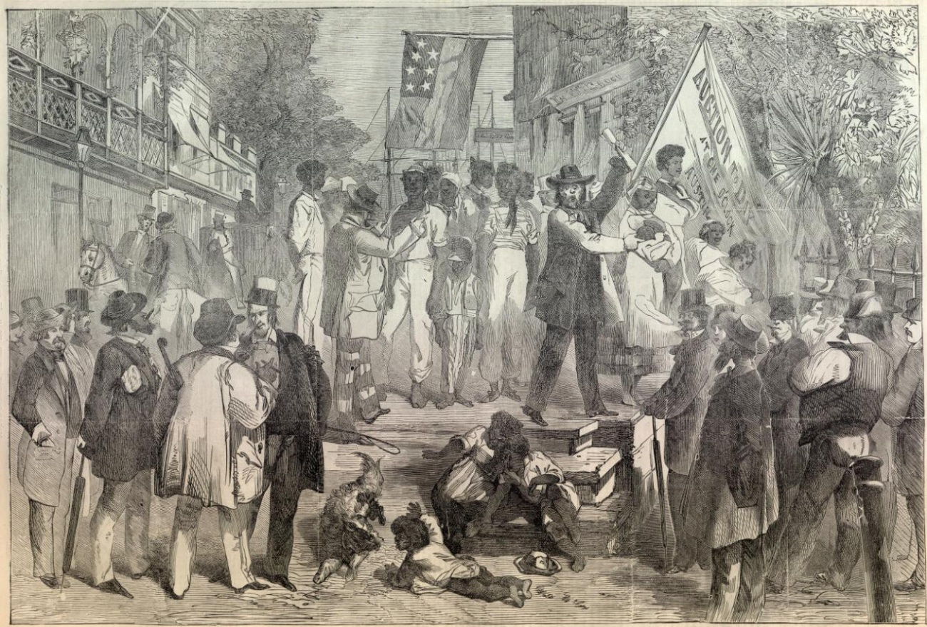
Slavery in the Constitution, 1788
Article I, Section 2, P. 3: “those bound to Service for a Term of Years.”
-“Those bound to slavery.”

Slide 23
Section 9, P. 1:”The Migration or Importation of such Persons as any of the States now existing shall think proper to admit, shall not be prohibited by the Congress prior to the Year one thousand eight hundred and eight, but a tax or duty may be imposed on such Importation, not exceeding ten dollars for each Person.”
-“Bringing slaves won’t be stopped before 1808, though the bringing of each slave can be taxed at maximum $10 each.”

Slide 24
“No Person held to Service or Labour in one State, under the Laws thereof, escaping into another, shall, in Consequence of any Law or Regulation therein, be discharged from such Service or Labour, but shall be delivered up on Claim of the Party to whom such Service or Labour may be due.”
-“No slave in a slave state escaping into a non-slave state can be freed from slavery, but must be returned to his or her master.”

Slide 25
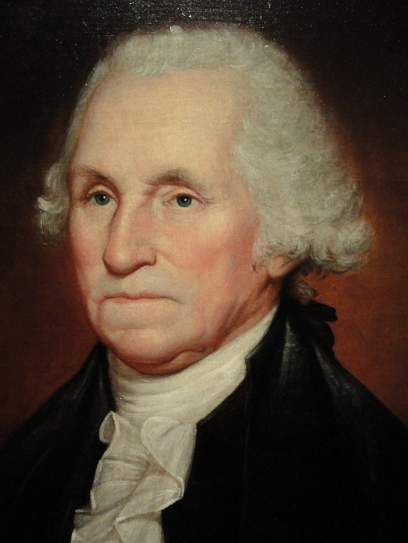
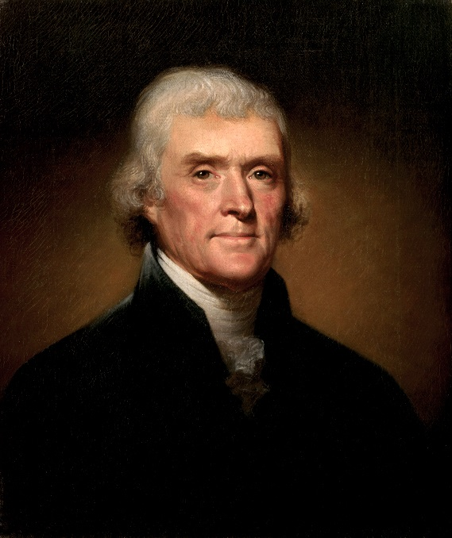
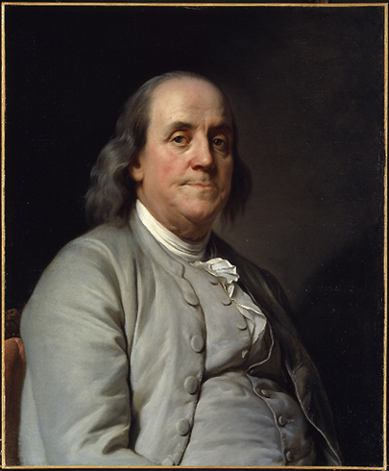
Contradictions (and progress)

Slide 26
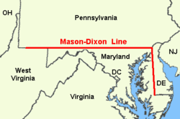
In 1787, Northwest Ordinance prohibited slavery in all future Great Lakes states, northwest of Ohio River.
By 1804, all states north of the Mason-Dixon Line (except for Delaware) had abolished slavery.

Slide 27
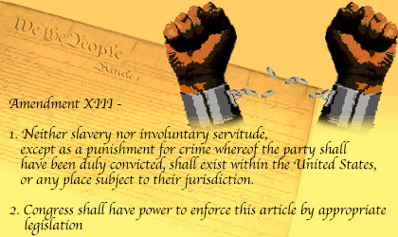
Justice?
Slavery is not fully abolished by the federal government until 1865, after the Civil War, with the Thirteenth Amendment.

Slide 28
Speech

Slide 29
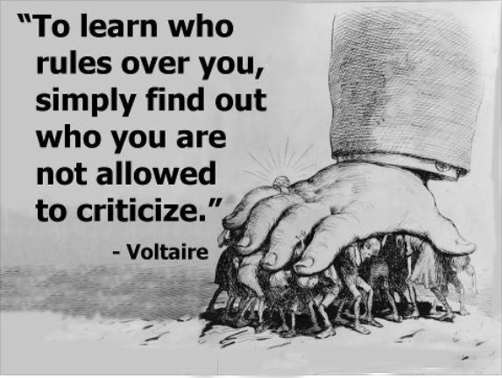
Notes:
We’ll find out of course that at various times, Americans have not been allowed to criticize gov.

Slide 30
First Amendment—1788
“Congress shall make no law respecting an establishment of religion, or prohibiting the free exercise thereof; or abridging the freedom of speech, or of the press; or the right of the people peaceably to assemble, and to petition the Government for a redress of grievances.”

Slide 31
An Act for the Punishment of Certain Crimes Against the United States—1798
“That if any person shall write, print, utter or publish, or shall cause or procure to be written, printed, uttered or published, or shall knowingly and willingly assist or aid in writing, printing, uttering or publishing any false, scandalous and malicious writing or writings against the government of the United States…shall be punished by a fine not exceeding two thousand dollars, and by imprisonment not exceeding two years.”
Notes:
This will happen many more times in history, most notably during red scares (among other civ liberty violations).

Slide 32
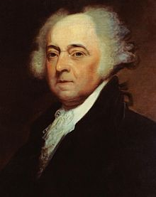
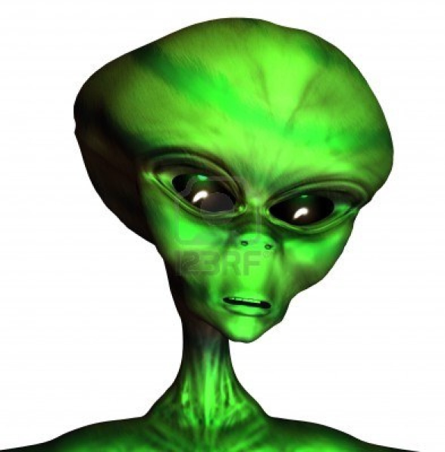
The Alien and Sedition Acts
President John Adams and the Federalist Party wanted to silence pro-French Revolution sentiments.
Repealed by pro-French Revolution President Jefferson and Democratic-Republicans in 1800.
Notes:
People often flaunt their first amendment rights, speech, religion, etc.

Slide 33
More Alien Acts—1798
Naturalization Act-immigrants had to be residents in US for 14 (instead of 5 previously) years before becoming eligible for citizenship.
Alien Act-authorized the President to deport aliens "dangerous to the peace and safety of the United States" during peacetime.
Alien Enemies Act-allows the wartime arrest, imprisonment and deportation of any alien subject to an enemy power.

Slide 34
How do these Acts match up with the First Amendment?

Slide 35
Native Americans

Slide 36
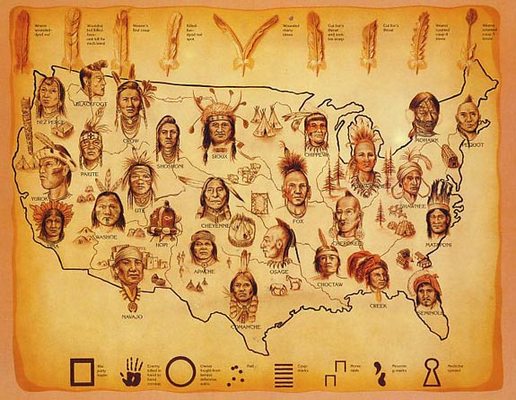
Native “Americans”
-Domestic or foreign? -Important to acknowledge that they did politically and violently resist, just like many other indigenous civilizations around the world did at various times
Notes:
People don’t realize that there were actual WARS!

Slide 37
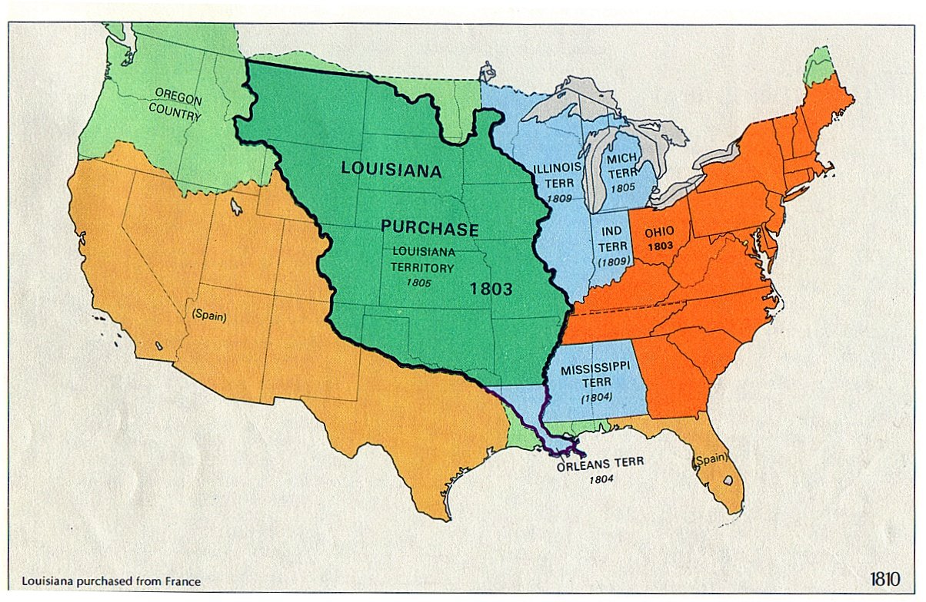
Manifest Destiny

Slide 38
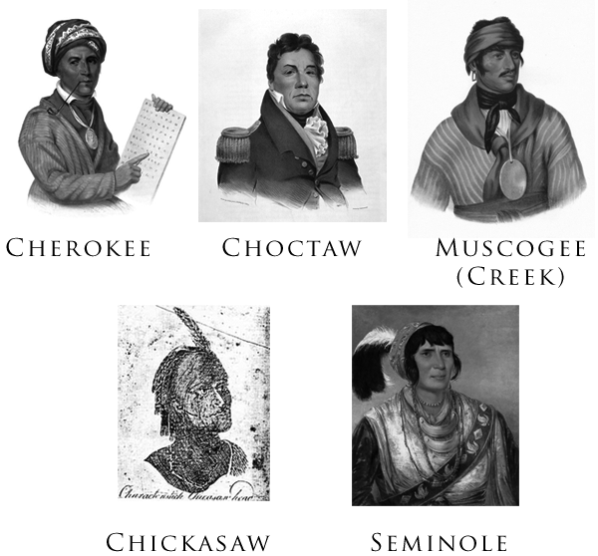
All quiet on the western frontier
East coast tensions continuing between Americans and the surviving natives
“The Five Civilized Nations”
Assimilation (for better or worse)

Slide 39
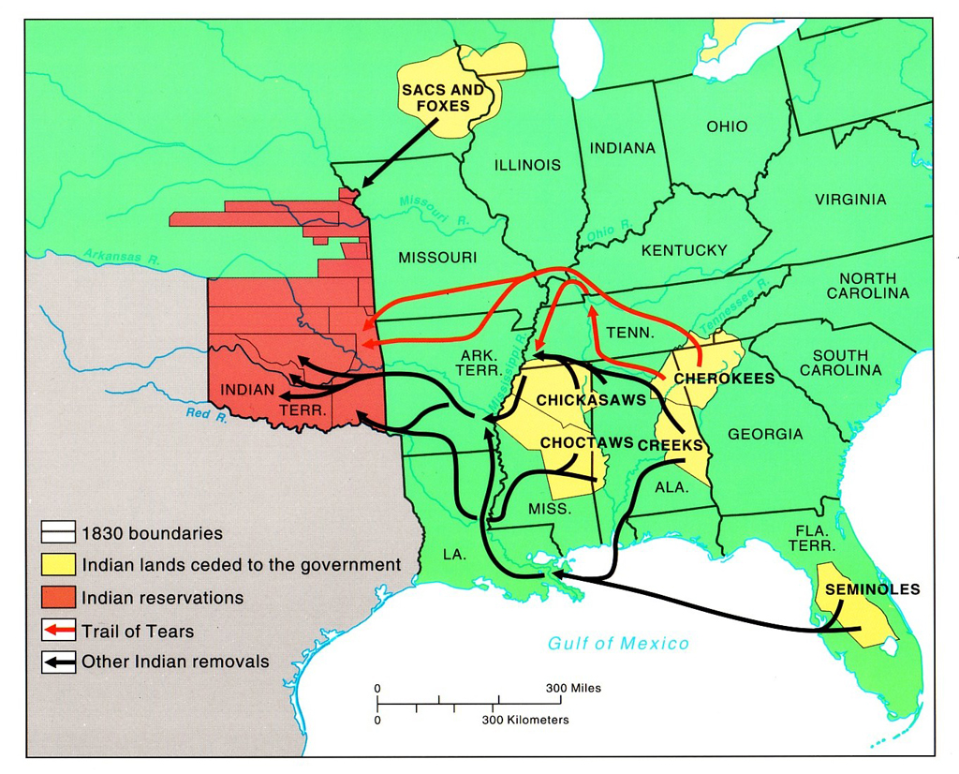
Indian Removal Act, 1830
“Voluntary”
Those who were “civilized” in American society were allowed to remain, but tribal groups had to go west

Slide 40
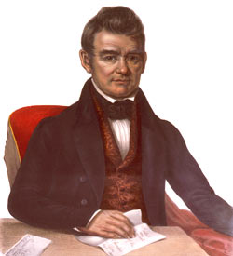
Cherokee Appeal
Chief John Ross (Guwisguwi)
Supreme Court in 1831 and 1832: native tribes were sovereign nations and were not subject to state laws

Slide 41
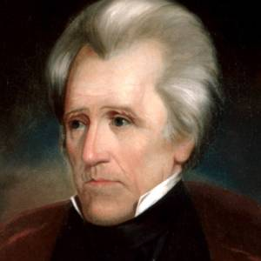
Jackson: “John Marshall has made his decision; now let him enforce it! ... Build a fire under them. When it gets hot enough, they'll go.”
Jackson rejects old friend Ross

Slide 42
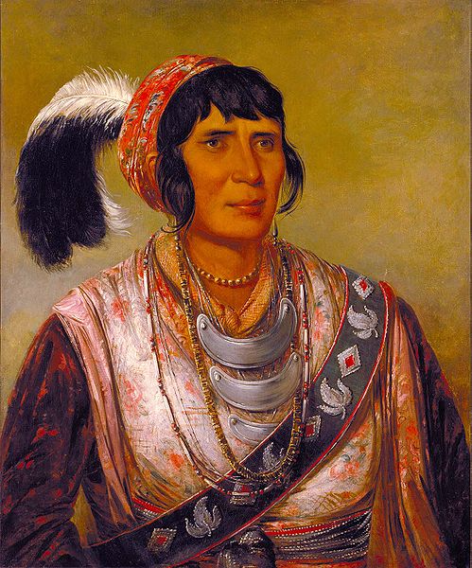
First Seminole War, 1814-1819: Seminole tribe in Florida, with escaped slaves, was aggressive towards American expansion into Florida. General Jackson fought them.
Second Seminole War, 1835-1842: Most expensive Indian War in US history.
Osceola, resisting Indian Removal.
Notes:
Blacks, not African Americans?

Slide 43
Trail of Tears
After Osceola’s capture and death in prison, and Seminole defeat.
1838-All natives, especially Cherokee, moved at gunpoint across Mississippi.
Several thousand died from starvation, disease, and exposure to weather along the way.

Slide 44
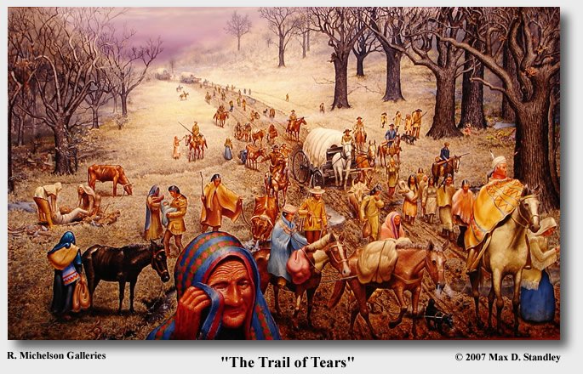

Slide 45
Is it harder to feel sympathy for the Seminoles because they killed Americans (some women and children too), as opposed to sympathy for the Cherokee who did not kill?
Some say Jackson felt that native tribes and Americans would not have been able to coexist. But would the Seminoles have killed so many Americans had Indian removal not been attempted?
Notes:
Context

Slide 46
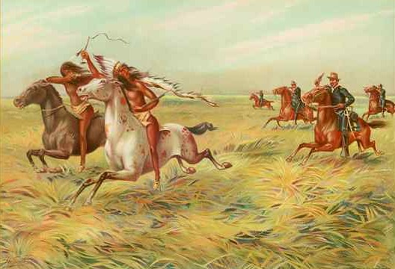
Treaty of Fort Laramie—1851
Natives would allow US miners and settlers to travel as long as the US prevented settlers from infringing into traditional native land claims.
Obviously, the governments, and various tribes began to violently retaliate.

Slide 47
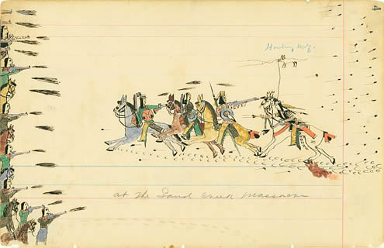
Sand Creek Massacre, 1864: in retaliation for Cheyenne aggression against settlers, army commander John Chivington led 700 US soldiers against Cheyenne in Colorado. 9 Americans, 150 Cheyenne. Over half were women and children. Soldiers mutilated bodies and took human souvenirs from the bloodbath.

Slide 48
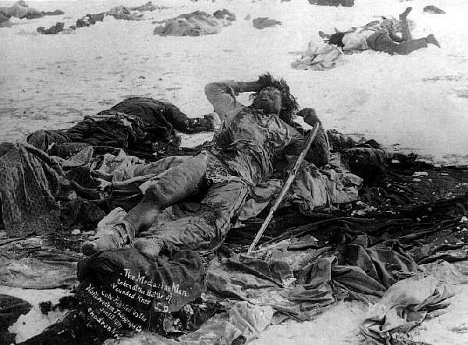
Wounded Knee Massacre, 1890: US cavalry surrounded a Lakota settlement in South Dakota celebrating a “Ghost Dance.” 25 Americans, 150-300 Lakota. Women, children, and old men.

Slide 49
Race & Gender

Slide 50
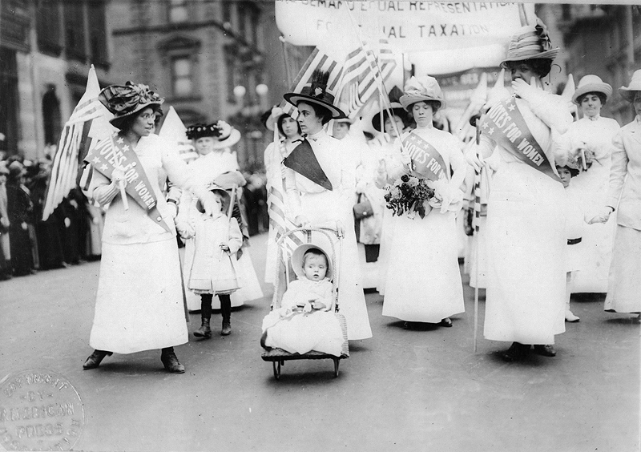
Comparison of Women’s Suffrage
1893-New Zealand
1902-Australia
1906-Finland
1913-Norway
1915-Denmark
1917-Canada
1918-Austria, Germany, Poland, Russia
1919-Netherlands
1920-United States

Slide 51
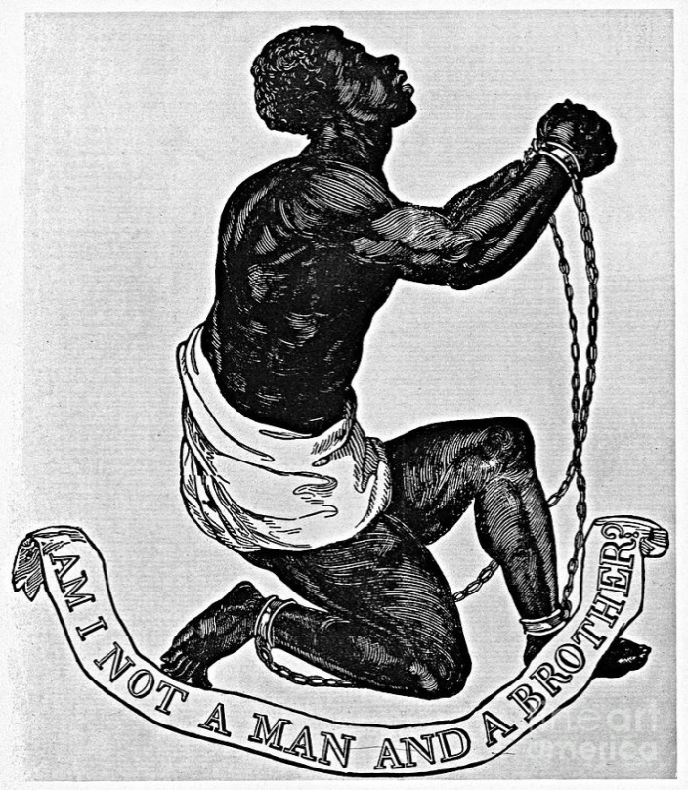
Comparison of Slavery Abolition
1811-Spain & colonies
1833-Britain & colonies
1848-France
1861-Dutch colonies
1865-United States
1857: enslaved and free African Americans could never become citizens.
Notes:
Dred Scott. Economic concerns?

Slide 52
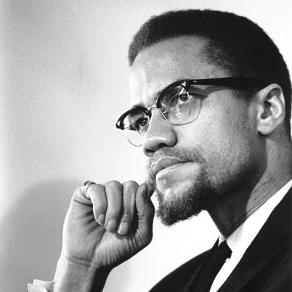
“If you stick a knife nine inches into my back and pull it out three inches, that is not progress. Even if you pull it all the way out, that is not progress. Progress is healing the wound.”—Malcolm X

Slide 53
Civil Rights
Section 1 of 14th Amendment: “No State shall make or enforce any law which shall abridge the privileges or immunities of citizens of the United States; nor shall any State deprive any person of life, liberty, or property, without due process of law; nor deny to any person within its jurisdiction the equal protection of the laws.”
Section 1 of 15th Amendment: The right of citizens of the United States to vote shall not be denied or abridged by the United States or by any State on account of race, color, or previous condition of servitude.

Slide 54
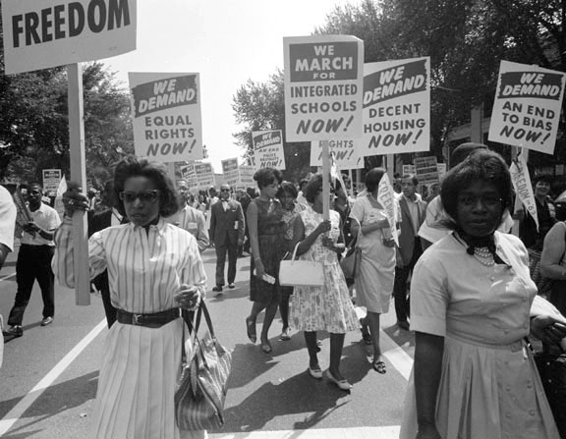
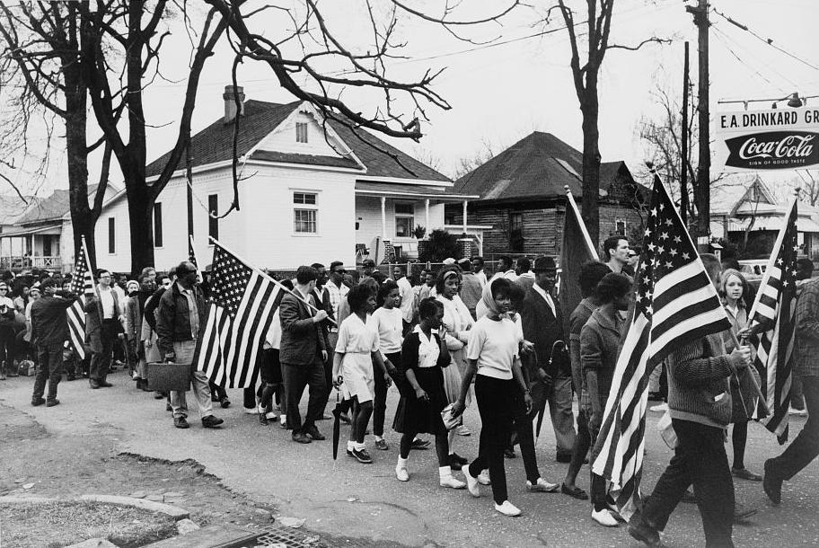
14th and 15th Amendments continuously violated by de jure segregation policies, including in the North.
“Separate but equal”: Plessy v. Ferguson.
Civil Rights Voting Rights Acts not passed until 1964 and 1965.

Slide 55
Back to 1941…
http://www.youtube.com/watch?v=3VqQAf74fsE

Slide 56
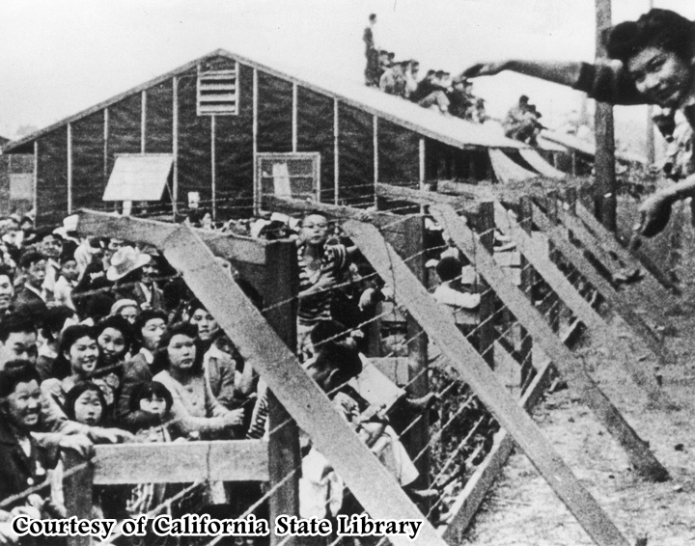

Slide 57
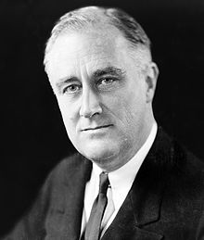
Executive Order 9066
“I hereby authorize and direct the Secretary of War, and the Military Commanders whom he may from time to time designate, whenever he or any designated Commander deems such action necessary or desirable, to prescribe military areas in such places and of such extent as he or the appropriate Military Commander may determine, from which any or all persons may be excluded, and with respect to which, the right of any person to enter, remain in, or leave shall be subject to whatever restrictions the Secretary of War or the appropriate Military Commander may impose in his discretion.”

Slide 58
115,000 Japanese-Americans moved to camps on west coast, 1942-1945.
Given little compensation, until 1988. Many of their homes and possessions were taken away during internment, and they had to start their livelihoods over again.

Slide 59
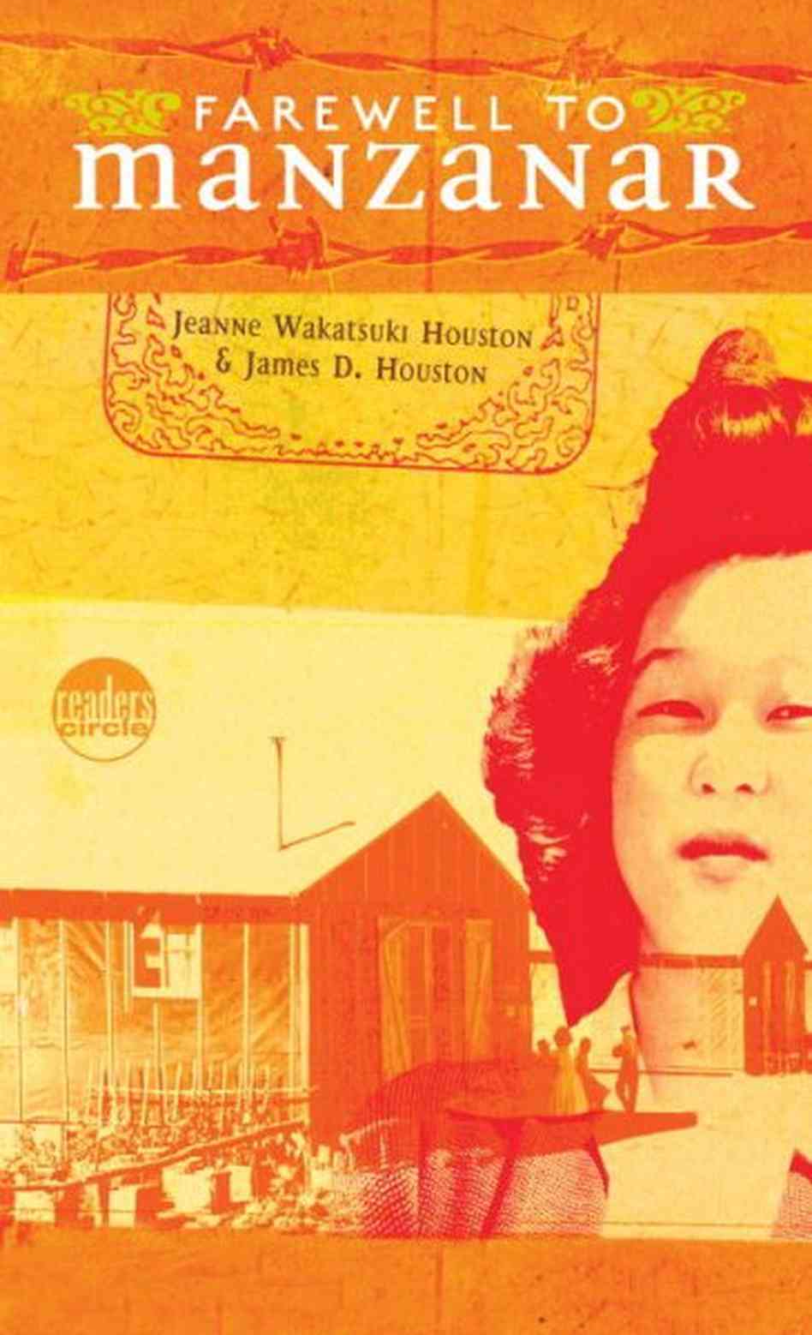
“When your mother and your father are having a fight, do you want them to kill each other? Or do you just want them to stop fighting?”

Slide 60
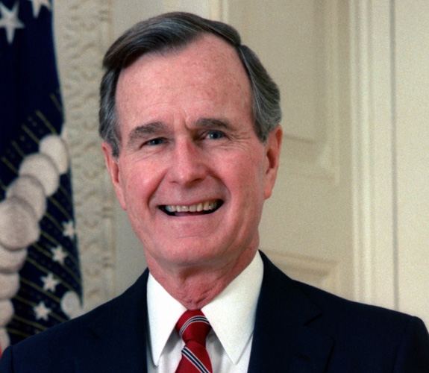
“No nation can fully understand itself or find its place in the world if it does not look with clear eyes at all the glories and disgraces of its past. We in the United States acknowledge such an injustice in our history. The internment of Americans of Japanese ancestry was a great injustice, and it will never be repeated.“—George Bush Sr., 1991

Slide 61
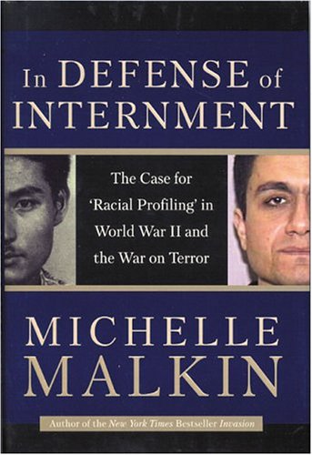

Slide 62
Cold War: The Land of the Free

Slide 63
Fourth Amendment
“The right of the people to be secure in their persons, houses, papers, and effects, against unreasonable searches and seizures, shall not be violated, and no Warrants shall issue, but upon probable cause, supported by Oath or affirmation, and particularly describing the place to be searched, and the persons or things to be seized.”

Slide 64
Sixth Amendment
“In all criminal prosecutions, the accused shall enjoy the right to a speedy and public trial, by an impartial jury of the State and district wherein the crime shall have been committed, which district shall have been previously ascertained by law, and to be informed of the nature and cause of the accusation; to be confronted with the witnesses against him; to have compulsory process for obtaining witnesses in his favor, and to have the Assistance of Counsel for his defence.”

Slide 65
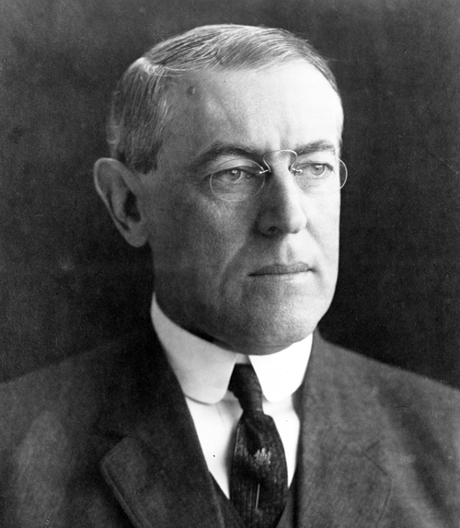
Sedition Act of 1918
Made it a crime to "willfully utter, print, write, or publish any disloyal, profane, scurrilous, or abusive language about the form of the Government of the United States" or to "willfully urge, incite, or advocate any curtailment of the production" of the things "necessary or essential to the prosecution of the war.”

Slide 66
An Act for the Punishment of Certain Crimes Against the United States—1798
“That if any person shall write, print, utter or publish, or shall cause or procure to be written, printed, uttered or published, or shall knowingly and willingly assist or aid in writing, printing, uttering or publishing any false, scandalous and malicious writing or writings against the government of the United States…shall be punished by a fine not exceeding two thousand dollars, and by imprisonment not exceeding two years.”
Notes:
This will happen many more times in hsitory, most notably during red scares (among other civ liberty violations).

Slide 67
Enter the Communists
1917: Russian people overthrow Czar Nicolas II, and a few months later form the Union of Soviet Socialist Republics.
Democracy and capitalism feel threatened by expansionist nature of communism as purported by Vladimir Lenin and Leon Trotsky (“red scare”).

Slide 68
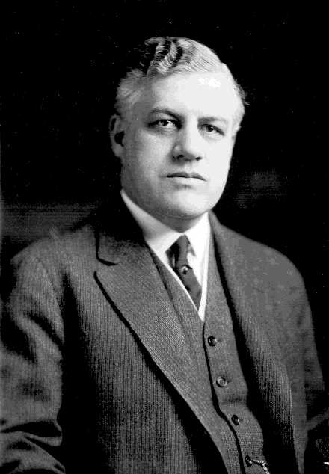
First Red Scare: 1919-1921
Leftists persecuted during this time due to both the Sedition Act and the Red Scare.
“Palmer raids” led by Attorney General A. M. Palmer. FBI unreasonably and unwarrantedly raided private residences, held suspects without legal representation or formal charges, set bail at abnormally high rates.

Slide 69
Second Red Scare: 1947-1957
1945: House Un-American Activities Committee (HUAC) established to investigate Americans with Marxist political affiliations. Trials of supposed Marxists with cultural influence violated many of the Bill of Rights Amendments previously mentioned.
Some artists, like Walt Disney, accused their colleagues of being leftists to make themselves look better.

Slide 70
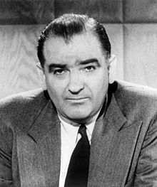
Investigations resulted in “blacklisting.” Many artists, especially screenwriters, were barred from employment due to at one point having been part of the American Communist Party and not complying with the intrusive government hearings spearheaded by Joseph McCarthy.
Notes:
Joe McCarthy

Slide 71
Pre-PRISM Surveillance
As the Cold War between the US and communism dragged on, the National Security Agency and FBI continued to monitor anyone who criticized the US war in Vietnam, which was perceived as being an important part of global anti-communist strategy.

Slide 72
Contemporary Controversies: Immigration, Gender-Sexual Minority, National Security

Slide 73
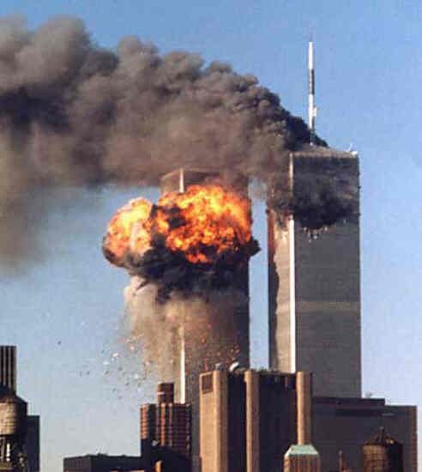

Slide 74
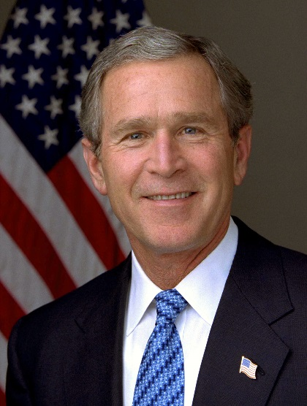
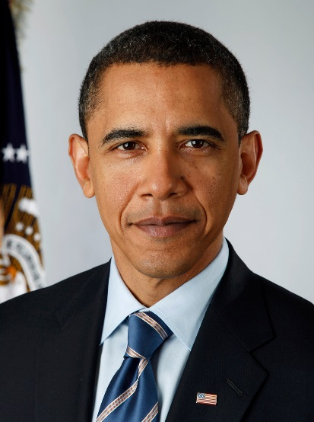
National security, free speech, and surveillance today: from anticommunism to antiterrorism
PATRIOT Act:
-indefinite detentions of immigrants
-searches of homes or businesses without owners’ or the consent
-FBI can search telephone, e-mail, and financial records without a court order
-expanded access of law enforcement agencies to business records

Slide 75
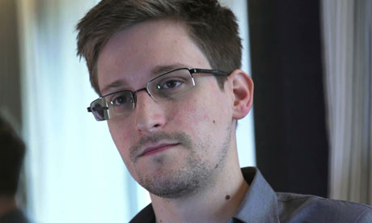
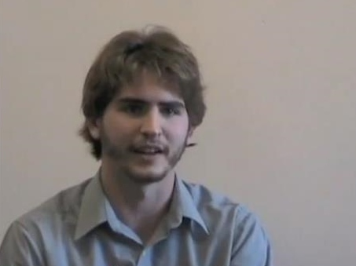
Wiretapping
Airlines security: http://www.youtube.com/watch?v=EwyNufXt0_0

Slide 77
Immigration

Slide 78
Gender-Sexual Minority/Diversity

Slide 79
Notes:
Revisiting the beginning…

Slide 80
Notes:
Anonymous internet people often have really insightful things to say!

Slide 81
Notes:
Beacons of hope. Glass half full or half empty. Go back to first quote and questions.

